Slide 1
Electronic monitoring proposal
Name:
Tutor:
Institution:

Slide 2
Introduction
Throughout my duration with the Harris County Juvenile Probation Department, I have witnessed many juveniles go on their home visits for 24 hours.
No one ever return back to the court to complete their time.
At one of the Harris County facilities the home visits are one of the perks of completing the program
However when a juvenile fail to come back to the facility that causes the County to lose money trying to locate the juvenile. I

Slide 3
Cont.
It also causes the other juveniles to not be able to go on their own home visits.
What I am proposing that we provide juvenile offenders an electronic monitoring device with GPS tracking included to assure that the juvenile offenders do return to facilities when they are temporarily released.
Also, the electronic monitoring device will help law enforcement locate the juvenile.

Slide 4
Research
Adolescents that are and have been in the court frameworks are starting to count.
The quantities of these adolescents are rising, and there are prime key factors that prompt this proceeding with issue.
In the present paper the Probation Officer might be a key factor to the jobs that the Probation Officer plays in their life.
It is realized that the Probation Officers have with enhancing their standard for dependability.
It has a merited notoriety for quality client benefit.

Slide 5
Con’td
Adolescents that are and have been in the court frameworks are starting to count.
The quantities of these adolescents are rising, and there are prime key factors that prompt this proceeding with issue.
In the present paper the Probation Officer might be a key factor to the jobs that the Probation Officer plays in their life.
It is realized that the Probation Officers have with enhancing their standard for dependability. has a merited notoriety for quality client benefit.
Notwithstanding, looked with changes in dissemination frameworks, financial effects to transportation and coordination, and impediments

Slide 6
Discussion
The electronic monitoring device incorporate the supervision of guilty parties through any electronic gadget that tracks the whereabouts of wrongdoers either irregularly or persistently.
After being alluded to an electronic checking program, wrongdoers must consent to pay the required expense set by the courts.
Guilty parties put on an electronic monitor are regularly managed by probation officers.
These officers oversee guaranteeing consistence with the court orders, exploring infringement, detailing back to the court, and guaranteeing gear fit and utilization.
In contrast to different officers of the court that expect some dimension of rehabilitative capacity, these officers are accused of guilty party the board and control rather than consideration.
In contrast to different options, were intended to be utilized related to other network-based projects, for example, house capture, curfews, network benefit, and so forth

Slide 7
Cont.
Guilty juvenile offenders might be put in electronic monitoring either pretrial or as an immediate sentence for probation through a network or redresses based program.
Electronic checking has been utilized with an assortment of guilty parties including sex wrongdoers, rough guilty parties, aggressive behavior at home wrongdoers, pack individuals, and medication guilty parties.
While every one of these projects contrasts by the motivation behind their organization, the supervision obligation continues as before.
The guilty parties get arbitrary phone calls for the duration of the day when they should be home.

Slide 8
Conclusion
In the first place, electronic observing is a less expensive option in contrast to customary imprisonment.
According to the Texas Juvenile Justice Department, it costs $437.11 a day to detain a juvenile.
Further gauges of the extended utilization of GPS innovation propose a yearly decrease in wrongdoing would establish $481.
1 billion in cost reserve funds. Further, by lessening the length of jail sentences from 85 to 50 percent of time served, the cost– advantage proportion to nationals would be a gain of $12.70 for each dollar consumed on GPS innovation.

Slide 9
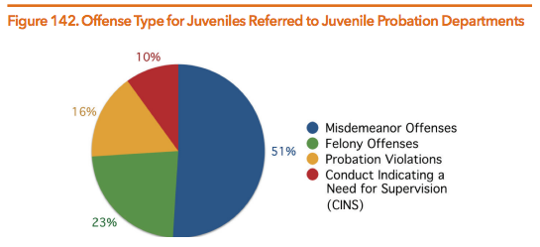
Cont.
Concentrates on states of mind of undergrads toward electronic observing show that while white understudies see electronic checking as an adequate impediment to wrongdoing, despite everything they trust it is excessively permissive. The most convincing contention for keeping up EM in the network is the decrease in recidivism. Electronic monitoring programs give a chance to keep up open wellbeing while sufficiently rebuffing and overseeing guilty parties in the network. GPS-directed guilty parties are more averse to slip off, and when contrasted with a coordinated controlled gathering of detainees less inclined to recidivate. Further, investigate shows that early discovery of infringement on electronic monitoring gadgets has brought about an abatement in recidivism by 94.7 percent contrasted with an imprisoned populace

